Slide 1

Rationale
Object-oriented concepts form the base of all modern programming languages.
Understanding the basic concepts of object-orientation helps a developer to use various modern day programming languages.
Java is an object-oriented language that enables you to create real-world applications.
The code reusability feature of Java enables the software developers to upgrade the existing applications without rewriting the entire code.
The concept of working with files and I/O streams enables the software developers to store and retrieve the information from a flat or a text file.
Packages enable the reusability of classes and methods across various applications.

Slide 2
Objectives
In this session, you will learn to:
  Identify the Object-oriented methodology
  Identify the advantages of the object-orientation
  Identify the features of the object-oriented approach

Slide 3
Defining Object Orientation
Object orientation:
  Software development methodology
  Relates to the real world
  Consists of classes
  Consists of objects:
    Example:
      Employee
      Window
      Car
  Objects can have inter-relationships
  Involves splitting the software system into component parts
  Arranges the parts in a hierarchy

Slide 4

The Foundation of Object Orientation
Object-oriented program:
  Consists of classes and objects
  Objects communicate with each other through messages
What are classes, objects, and
messages?

Slide 5
Objects
Object :
  Means a material thing
  Presented physically
  Has a state
  Displays behavior
  Has a unique identity

Slide 6

Objects (Contd.)
Two objects:
  May have the same behavior and state
  Can never have the same identity
Let us consider an example.

Slide 7
Objects (Contd.)
Movement of the car defines its behavior.
A car positioned at one place defines its state.
The car’s registration number, MMY 88, shows its identity.
MMY 88

Slide 8
Classes
Class:
  Consists of a set of objects
  Objects share a common structure and behavior
Object programming terminology:
  Data within an object represents its state:
    Data is termed as attribute
Methods:
  Have a behavior
  Contain code to implement behavior
  Associated using objects
  Have a set of instructions
  Have a unique purpose
  Implement behavior of the object

Slide 9
Classes (Contd.)
An object is an instance of a class.
Let us consider an example.

Slide 10
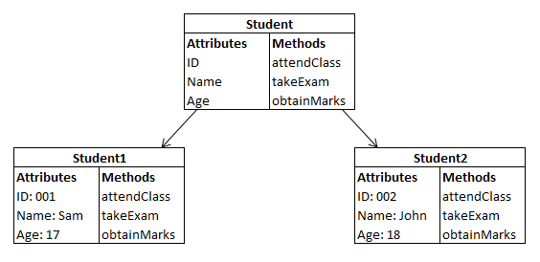
Classes (Contd.)
Class
Object of the Student Class
Object of the Student Class

Slide 11
Messages and Methods
Messages are used for communication between objects.
Let us consider an example.

Slide 12
Messages and Methods (Contd.)
A car is flashing its lights to pass messages to the other car.

Slide 13

Quiz

Slide 14
Quiz (Contd.)
Identify the possible states of the following objects:
  A mobile phone
  An MP3 player
Solution:
  States of a mobile phone: Off, Ring, Vibrate, and Call
  States of an MP3 Player: Play, Stop, Rewind, and Forward

Slide 15
Quiz (Contd.)
John went to a shopping mall to buy some clothes. The door of the shopping mall was automatic, which opened as soon as John stepped near it and closed as soon as John entered the mall. Identify the following:
  The possible receiver of the message.
  The possible method that the receiver can use.
Solution:
  The receiver of the message will be the door of the shopping mall.
  The door will use the method, Open Door, when John steps near it and Close Door when he enters the mall.

Slide 16
Advantages of Object Orientation
What are the advantages of the object-oriented approach?

Slide 17

Advantages of Object Orientation (Contd.)
Realistic modeling:
  Models the real world
MMY 88
Real-world object
Object-oriented representation of the real-world object

Slide 18
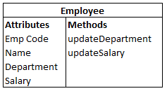
Advantages of Object Orientation (Contd.)
Reusability:
  Allows to reuse existing classes or objects
Payroll application
Leave accounting
application
Employee recruitment
application
Employee Class

Slide 19
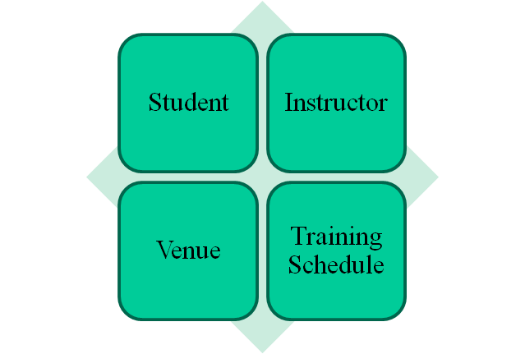
Advantages of Object Orientation (Contd.)
Modularity:
  Allows objects to be maintained independent of each other
Independent Objects in
Training Management System

Slide 20
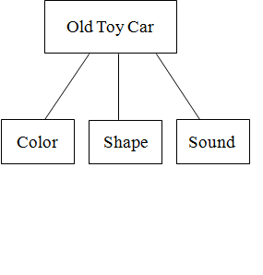
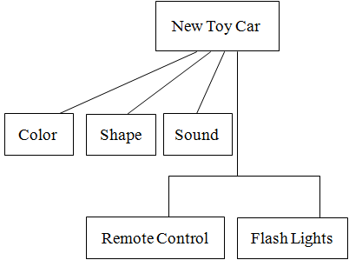
Advantages of Object Orientation (Contd.)
Flexibility to change:
  Allows to create a new class
  New class can add features to an existing class

Slide 21


Advantages of Object Orientation (Contd.)
Information hiding:
  Allows programmers to limit the access to information
A person who is saving a file on a computer does not know how the computer saves the file on the hard disk.
The person just knows that clicking the Save button will save the file.

Slide 22
Summary
In this session, you learned that:
  Object orientation is a software development methodology that relates to the real world.
  An object is an instance of a class.
  The advantages of the object-oriented approach are:
    Realistic modeling
    Reusability
    Modularity
    Flexibility to change
    Information hiding

